Slide 1
Edge Detectors

Slide 2
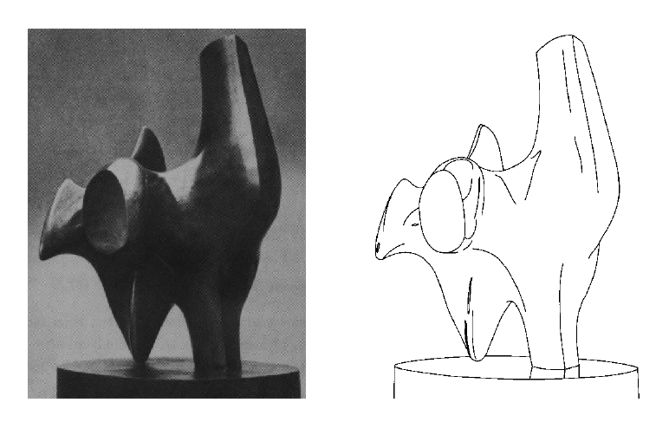
Edge Detection
Convert a 2D image into a set of curves
Extracts salient features of the scene
More compact than pixels

Slide 3
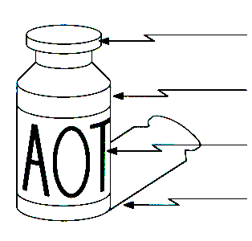
Edges
Edges are caused by a variety of factors
surface normal discontinuity
depth discontinuity
surface color discontinuity
illumination discontinuity

Slide 4
Edges
Edge is Where Change Occurs
Change is measured by derivative in 1D
Biggest change, derivative has maximum magnitude
Or 2nd derivative is zero.

Slide 5
Image Gradient
The gradient of an image:
The gradient points in the direction of most rapid change in intensity

Slide 6
Image Gradient
gradient direction
The edge strength
Discrete Gradient: by finite differences
f(x+1,y) – f(x,y)
f(x, y+1) – f(x,y)

Slide 7
Types of Edges

Slide 8
Sobel Operator
Better approximations of the derivatives
Sobel operators
The standard def. of the Sobel operator omits the 1/8 term
Doesn’t make a difference for edge detection
The 1/8 term is needed to get the right gradient value
-1 | 0 | 1
-2 | 0 | 2
-1 | 0 | 1
1 | 2 | 1
0 | 0 | 0
-1 | -2 | -1

Slide 9
Sobel Operator - Result
Original
Convolution with Sobel
Thresholding
(Value = 64)
Thresholding
(Value = 96)

Slide 10
Noise - Effect

Slide 11
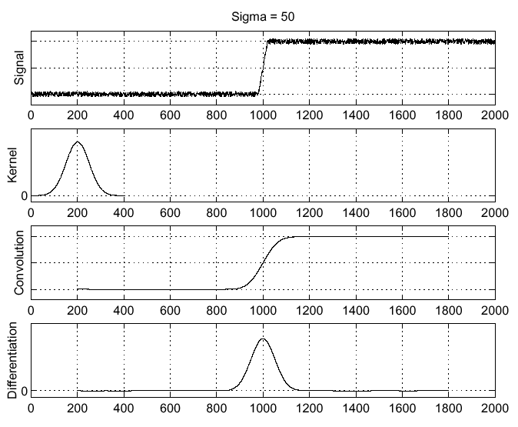
Solution: Smooth First

Slide 12
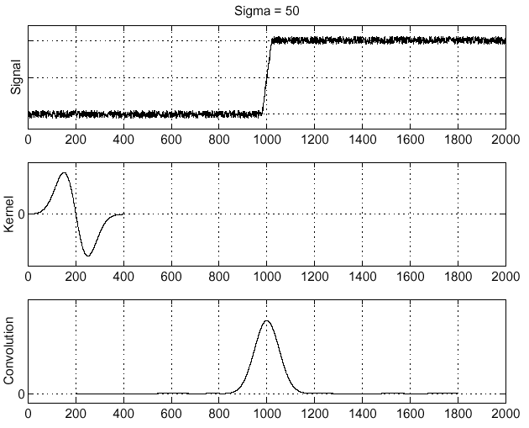
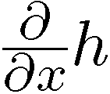
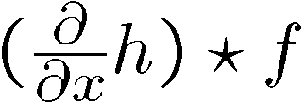
Derivative Theorem
This saves us one operation:

Slide 13
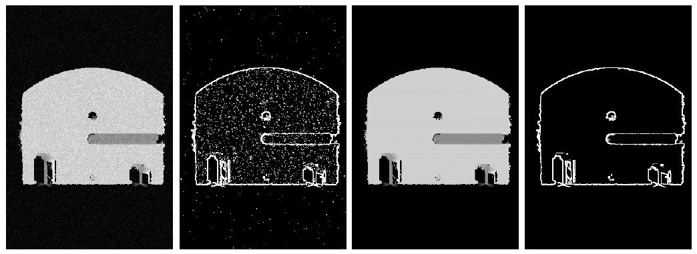
Result
Without Gaussian
With Gaussian

Slide 14
Second derivative
f(x+1, y) – 2f(x,y) + f(x-1,y)
In 2D
What is an edge?
Look for zero crossings
With high contrast
Laplacian Kernel

Slide 15
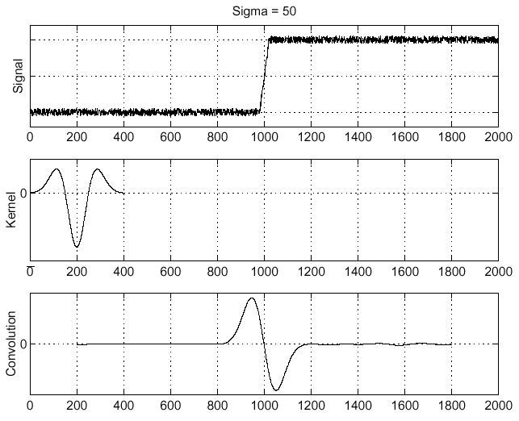
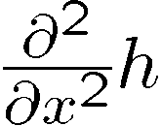
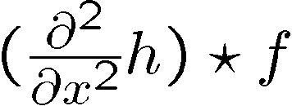
Laplacian of Gaussian

Slide 16
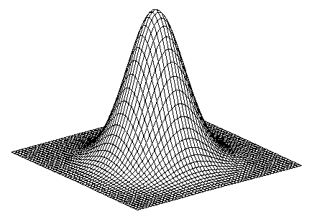
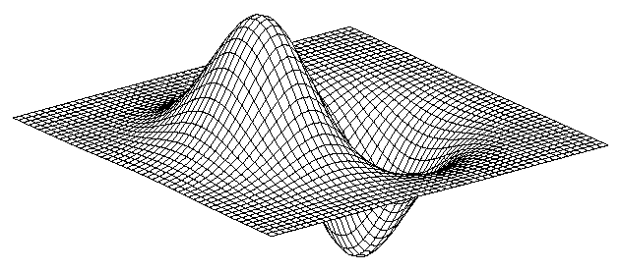
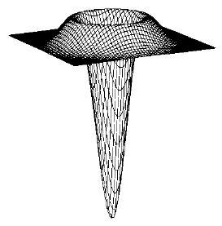
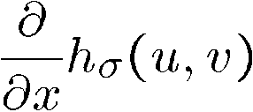
2D edge detection filters
Laplacian of Gaussian
Gaussian
derivative of Gaussian

Slide 17
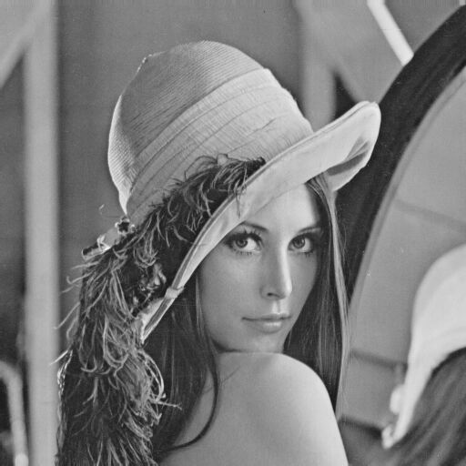
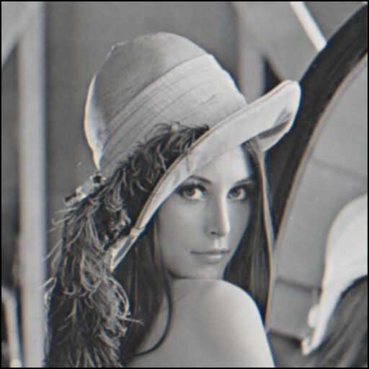
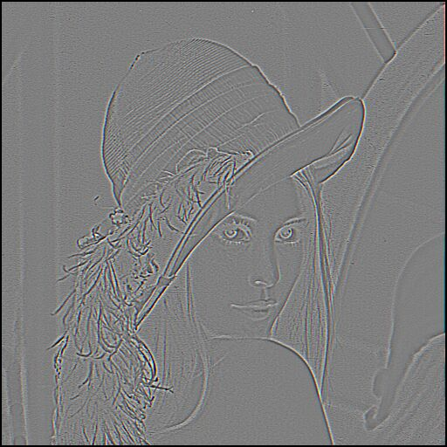
Edge detection by subtraction
original
smoothed
smoothed – original

Slide 18
Laplacian of Gaussian
Gaussian
delta function
Laplacian of Gaussian

Slide 19
Optimal Edge Detection: Canny
Assume:
Linear filtering
Additive Gaussian noise
Edge detector should have:
Good Detection. Filter responds to edge, not noise.
Good Localization: detected edge near true edge.
Minimal Response: one per edge
Detection/Localization trade-off
More smoothing improves detection
And hurts localization.

Slide 20
Canny Edge Detector
Suppress Noise
Compute gradient magnitude and direction
Apply Non-Maxima Suppression
Assures minimal response
Use hysteresis and connectivity analysis to detect edges

Slide 21
Non-Maxima Suppression
Edge occurs where gradient reaches a maxima
Suppress non-maxima gradient even if it passes threshold
Only eight directions possible
Suppress all pixels in each direction which are not maxima
Do this in each marked pixel neighborhood

Slide 22
Hysteresis
Avoid streaking near threshold value
Define two thresholds – L , H
If less than L, not an edge
If greater than H, strong edge
If between L and H, weak edge
Analyze connectivity to mark is either non-edge or strong edge
Removes spurious edges

Slide 23
Steps of Canny Edge Detector
Original
Gradient
Magnitude
Non-Maximum
Suppression
After
Hysteresis

Slide 24
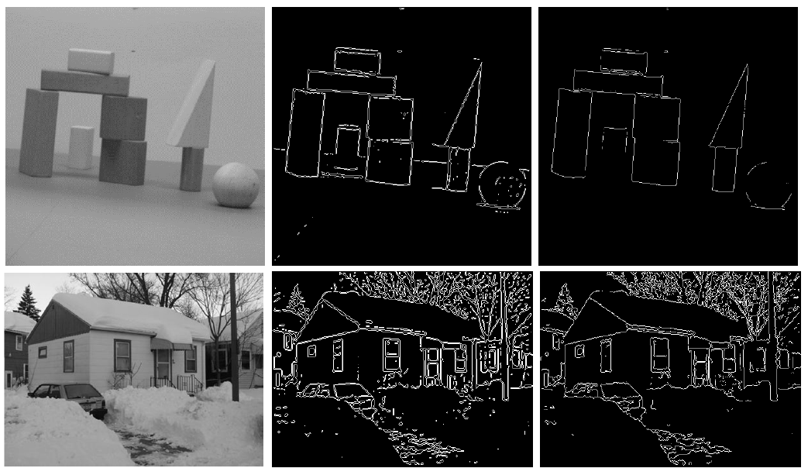
Comparison with Laplacian Based
Original
Curvature
Based
Canny

Slide 25
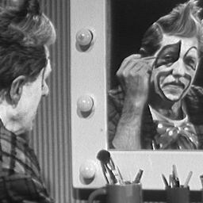
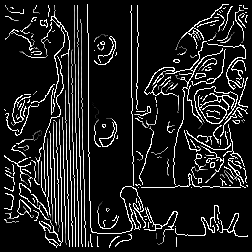
Effect of Smoothing (kernel size)
original
Canny with
Canny with

Slide 26
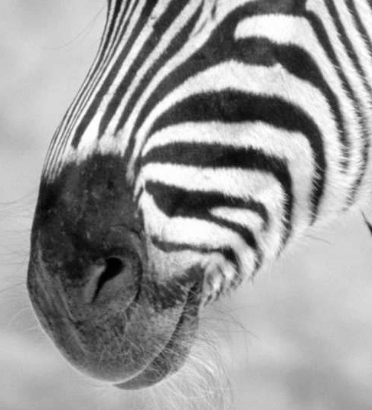
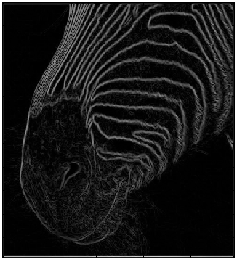
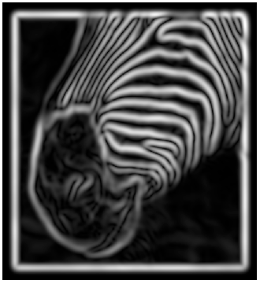
Multi-resolution Edge Detection
Smoothing
Eliminates noise edges.
Makes edges smoother.
Removes fine detail.
(Forsyth & Ponce)
Notes:
Figures show gradient magnitude of zebra at two different scales

Slide 27
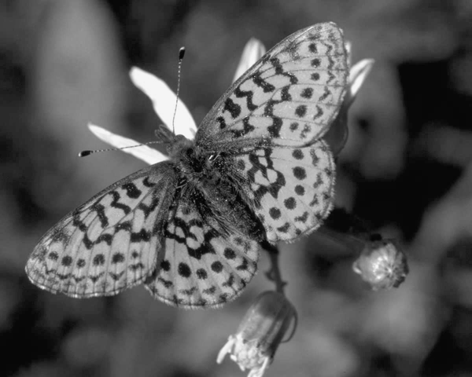

Slide 28
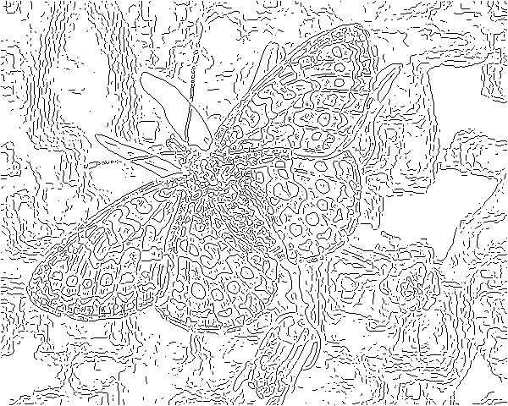
fine scale, high threshold

Slide 29
coarse scale, high threshold

Slide 30
Coarse scale, low threshold

Slide 31
Identifying parametric edges
Can we identify lines?
Can we identify curves?
More general
Can we identify circles/ellipses?
Voting scheme called Hough Transform

Slide 32
Hough Transform
Only a few lines can pass through (x,y)
mx+b
Consider (m,b) space
Red lines are given by a line in that space
b = y – mx
Each point defines a line in the Hough space
Each line defines a point (since same m,b)
(x,y)

Slide 33
How to identify lines?
For each edge point
Add intensity to the corresponding line in Hough space
Each edge point votes on the possible lines through them
If a line exists in the image space, that point in Hough space will get many votes and hence high intensity
Find maxima in Hough space
Find lines by equations y – mx+b

Slide 34
Example

Slide 35
Problem with (m,b) space
Vertical lines have infinite m
Polar notation of (d, θ)
d = xcosθ + ysinθ
d
θ
(0,0)

Slide 36
Basic Hough Transform
Initialize H[d, θ]=0
for each edge point I[x,y] in the image
for θ = 0 to 180
d = xcosθ + ysinθ
H[d, θ] += 1
3. Find the value(s) of (d, θ) for max H[d, θ]
A similar procedure can be used for identifying circles, squares, or other shape with appropriate change in Hough parameterization.

Slide 37
Non-Linear Filters

Slide 38
Corner Detections
Corners have more lines passing through them than pixels on edges
Should be easier
But edge detectors fail – why?
Right at corner, gradient is ill-defined
Near corner, gradient has two different values

Slide 39
Moravec Operator
Self-similarity
How similar are neighboring patches largely overlapping to me?
Most regions - Very similar
Edges - Not similar in one direction (perpendicular to edge)
Corners – not similar in any direction
Interest point detection – not only corners

Slide 40
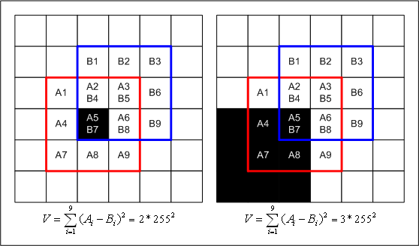
Measuring self-similarity
SSD = Sum of squared differences
Corner is local maxima

Slide 41
Limitations
Sensitive to noise
Responds for isolated pixel
Larger patches for robustness

Slide 42
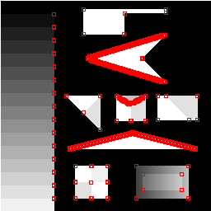
Limitations
Responds also to diagonal edges

Slide 43
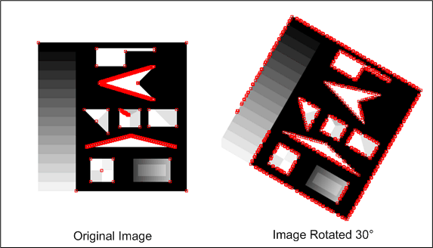
Limitations
Anisotropic (Not rotationally invariant)

Slide 44
Harris & Stephens/Plessey Corner Detector
Consider the differential of the corner score with respect to direction
Describes the geometry of the image surface near the point (u,v)

Slide 45
How to find the corner?
The eigenvalues are proportional to the principal curvatures
If both small, no edge/corner
If one big and one small, edge
If both big, then corner

Slide 46
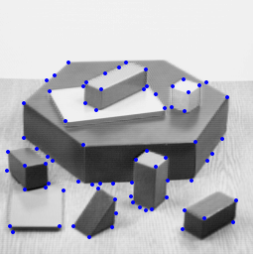
Rotationally Invariant
If w is Gaussian, then this is isotropic

Slide 47
Non-linear filters: Median filter
Replace by median of the neighborhood
No new gray levels
Removes the odd man out
Good for outlier removal
Retains edges

Slide 48
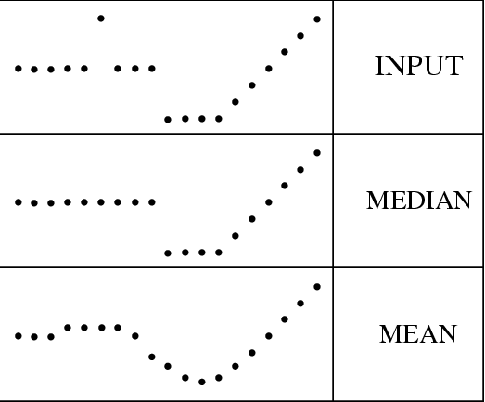
Median filter

